Slide 1
Project-3
GLOBAL PROSPECTIVE ON COVID 19

Slide 2
WHAT DID WE LOOK AT
Analysis on COVID 19 and it’s impacts to:
The U.S
Countries Around the World

Slide 3
Data sources
WORLD HEALTH ORGANIZATION (WHO)

Slide 4
DATABASES
LIBRARIES
BOOSTRAP
PLOTLY
MATPLOTLIB
LEAFLET
ML
SKLEARN
NUMPY
LANGUAGES
PANDAS
TABLEAU
JAVASCRIPT
JAVASCRIPT
HTML
CSS
PYTHON

Slide 5
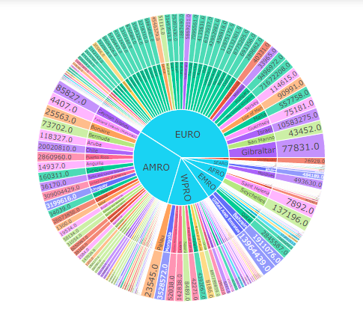
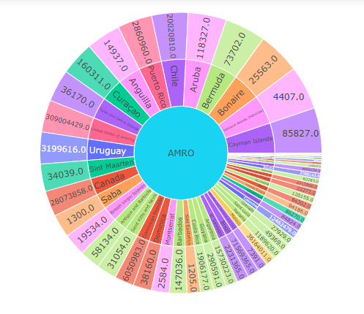
Jordan

Slide 6
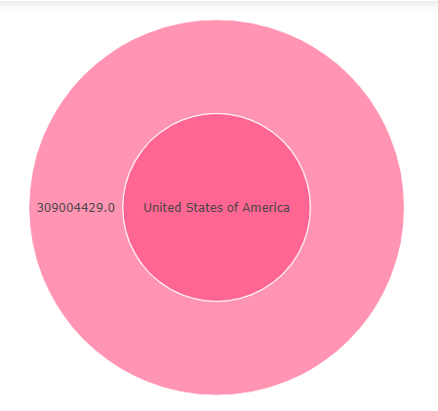
Jordan
The sunburst chart is an interactive chart that gives a refreshing way to view data from various sources all encompassed in one neat platform.

Slide 7
Mohammed

Slide 8

Explanation
1
2
2
2
2

Slide 9
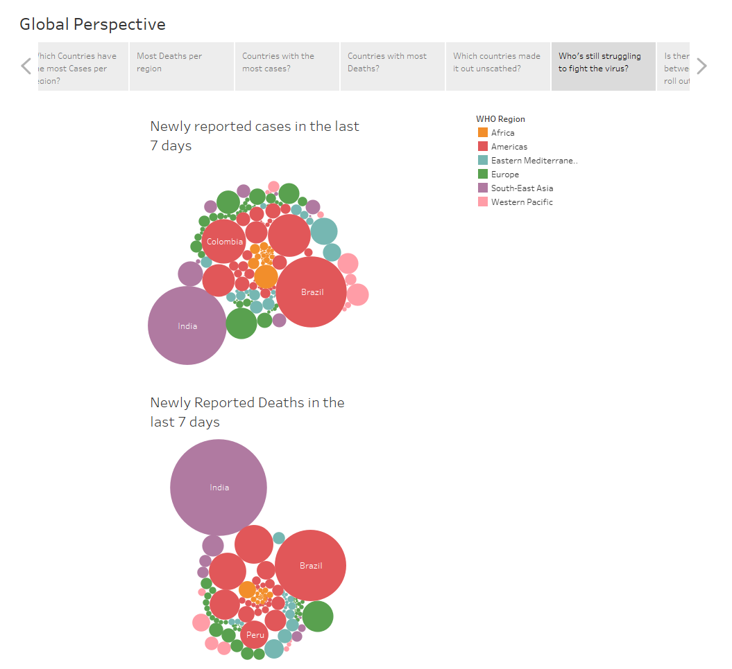
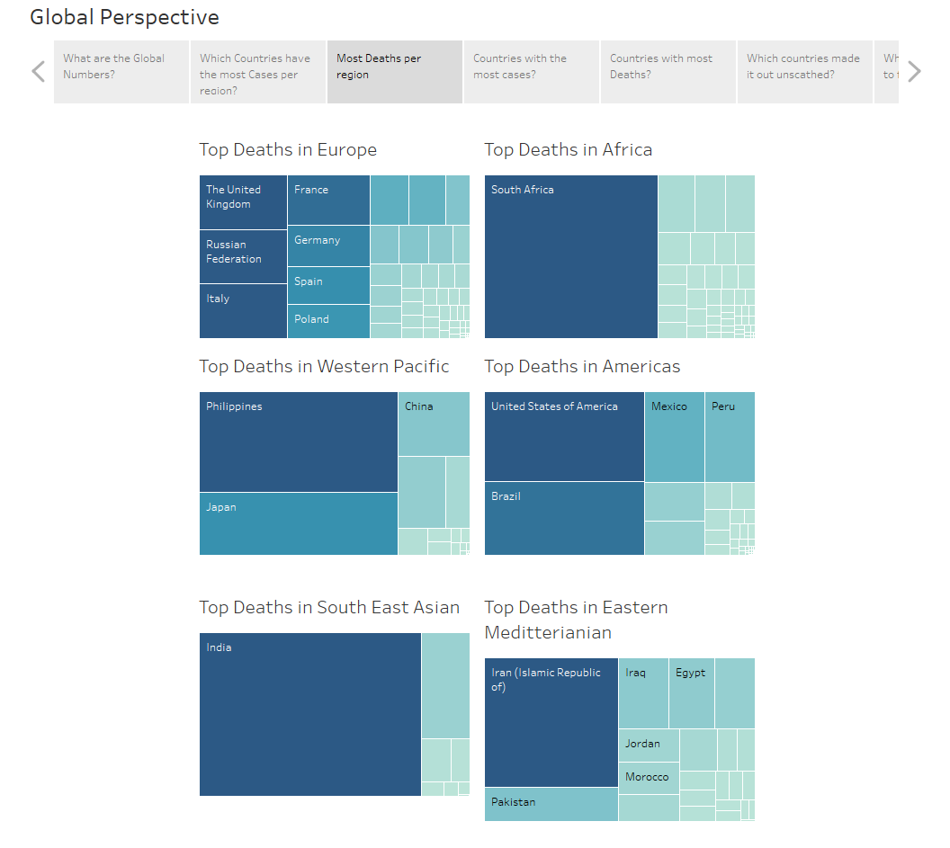
Global prospective
TABLEAU (dashboards)
FILTERS
COLOR
SIZE
TEXT
DETAILS

Slide 10

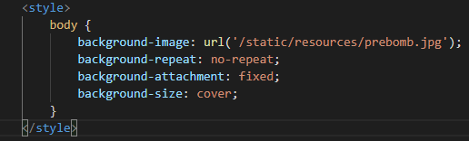
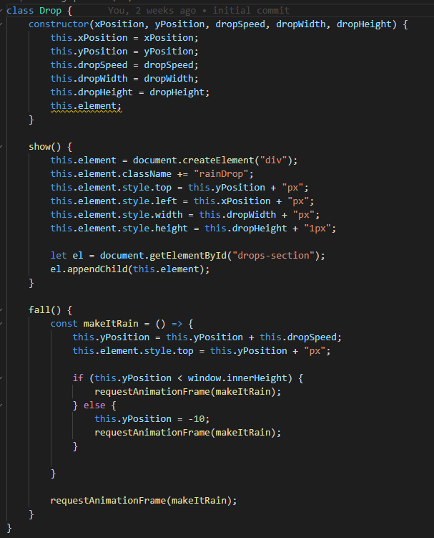
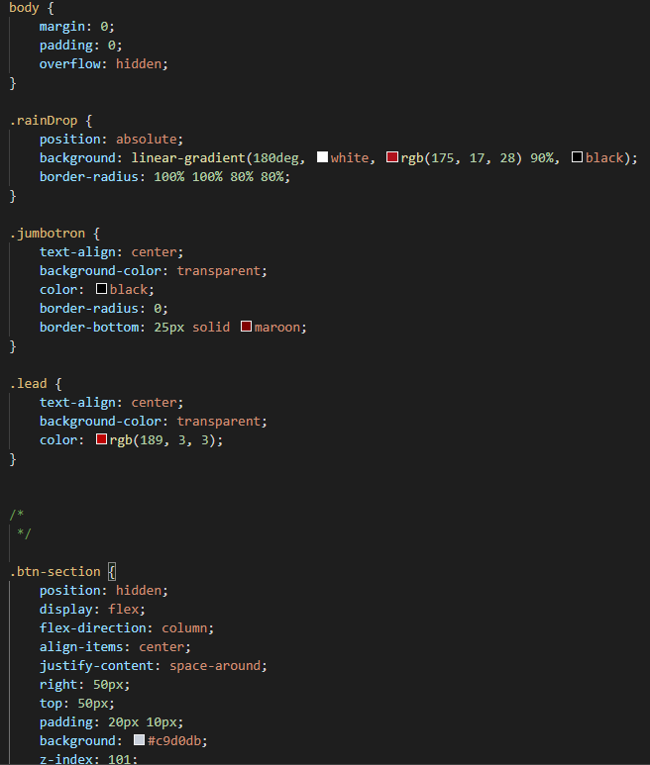
John
CSS CODE

Slide 11
What worked
Data Synchronization
Teamwork
Data Collection
Website development
Cooperation

Slide 12
Roadblocks
Time
Data

Slide 13
Final analysis
The data showed inconclusive evidence that vaccinations attribute to a decline in covid cases
WHATS NEEDED
Time
More Variables
Accurate Reporting
Covid Guidance

Slide 14
fin

